Slide 1

CHITTAGONG UNIVERSITY OF ENGINEERING & TECHNOLOGY
DEPARTMENT OF ELECTRONICS AND TELECOMMUNICATION ENGINEERING
COURSE CODE:CSE380
Course Title: Internet Programming
Project Title: E-learning Web Application
Presented TO:
Presented By:
Priyanti Paul Tumpa
Tayba Busra (1908017)
Lecturer, Department of Electronics and Telecommunication Engineering at CUET
M.I. Yasir Arafat(1908031)

Slide 2





TEAM A&B
OUR CAMPUS
www.ourcampus.com

Slide 3

TEAM A&B
WELCOME TO OUR CAMPUS
Offering engaging on-demand, immersive, and cohort-based learning, OUR CAMPUS aids in achieving Learning objectives and maintains competitiveness. With the help of our strategic alliances and integrated learning solutions, we provide individuals with the resources they need to develop a workforce that is prepared for the future, boost employee morale, and succeed.

Slide 4



Team A&B
WHAT DO YOU KNOW ABOUT INTERNET PROGRAMMING ?
It deals with the structure and functionality of the world wide web, create static and dynamic web pages using a combination of HTML, CSS, and JavaScript, by applying essential programming skills in creating HTML forms, select an appropriate web hosting service, and publish your web pages globally

Slide 5



Team A&B
VISION & MISSION
Vision
Tomorrow’s skills — today
Mission
Our mission is to provide flexible, effective web applications to empower organizations and individuals.

Slide 6


Team A&B
IMPLEMENTATION
PHASE 1
PHASE 2
PHASE 3
Formulating the code and planning the layout
Idea Generation &Selection
Build a Webpage with basic HTML&CSS

Slide 7






Team A&B
SERVICE 001
SERVICE 004
Blog Content
Hackathon
SERVICE 002
SERVICE 005
Full Courses and Video Tuitorial
Hardware project assemble
SERVICE 003
SERVICE 006
Community
Training on Workshop

Slide 8


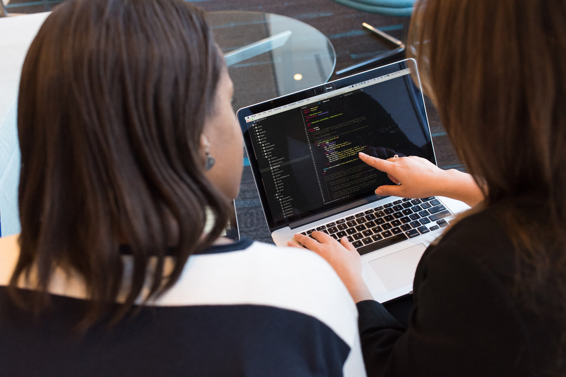



TEAM A&B
SPECIAL SERVICE
01
02
"Revolutionize your learning journey with our innovative text-to-speech feature, allowing you to absorb knowledge effortlessly through engaging audio narration."
"Maximize your earning potential with our unique side hustle feature, turning your spare time into valuable income through exciting opportunities."
03
04
"Ignite your competitive spirit as you vie against fellow learners, pushing each other to reach new heights of knowledge and achievement."
"Embark on a transformative learning experience with our Expert Mentorship Program,

Slide 9
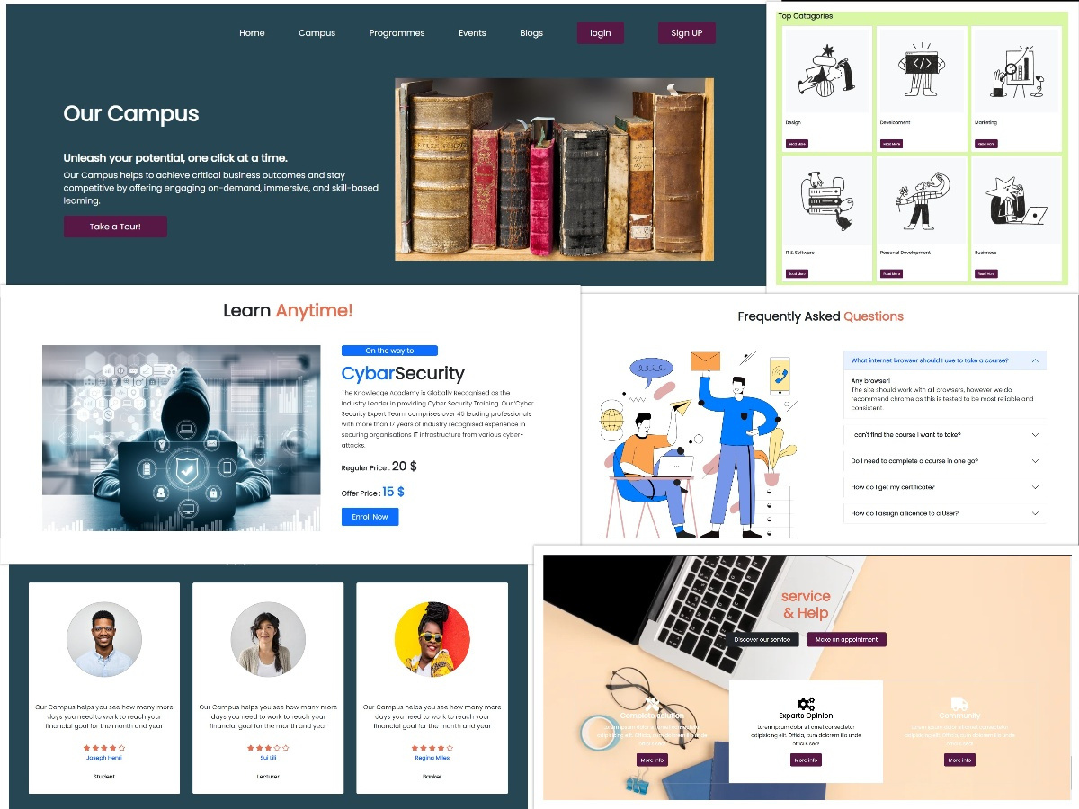
Team A&B
Navigation Bar
Header
Body section
Footer

Slide 10

Team A&B
THANK YOU
www.ourcampus.com

Slide 11


Team A&B

